Slide 1
Effective Data Visualization Workshop
Kira Tebbe - February 25, 2020

Slide 2
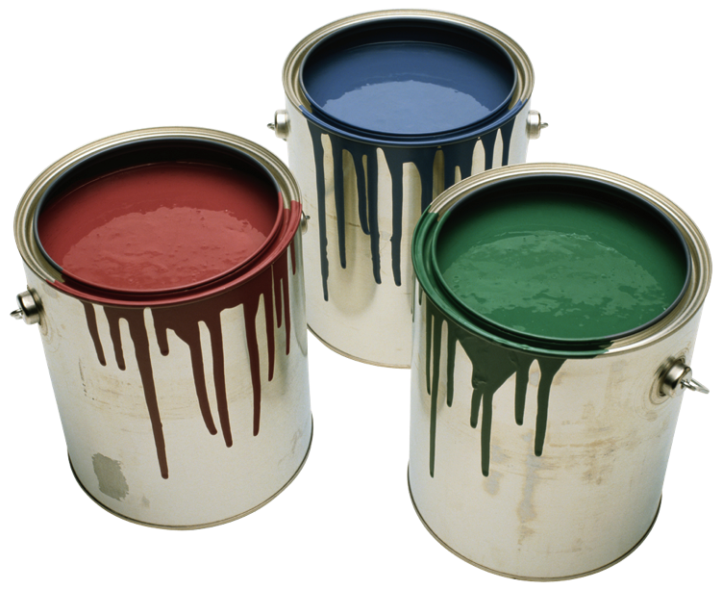







Who is this person I’m listening to???
Data science + sociology = seeing patterns through the noise
Notes:
Not a designer! I approach data viz from a communication/information perspective

Slide 3
Why is data visualization important?
What is wrong with these plots?
What are the important parts of a visualization?
What are my best practices?
How would you visualize this data?

Slide 4
Why is data viz important?

Slide 5
Data = information
Data visualization = communication
Good data visualization = effective communication
Notes:
Visual needs to stand on its own – anyone could look at it without you and understand your message

Slide 6
What do mediocre visualizations give us?
Misleading results
Incorrect interpretations
Confusion
Lack of attention
Worse impression of work quality
Notes:
Many different goals of data viz: convincing audience, reporting on outcomes (trust is already there), presenting technical/niche topic to wider audience
Not putting time into your visualization is like spending months preparing a ballet recital and then doing it on a basketball court with 75% lights burned out – probably great, but your audience isn’t going to see it as well as they could

Slide 7
What’s wrong with these plots?

Slide 8
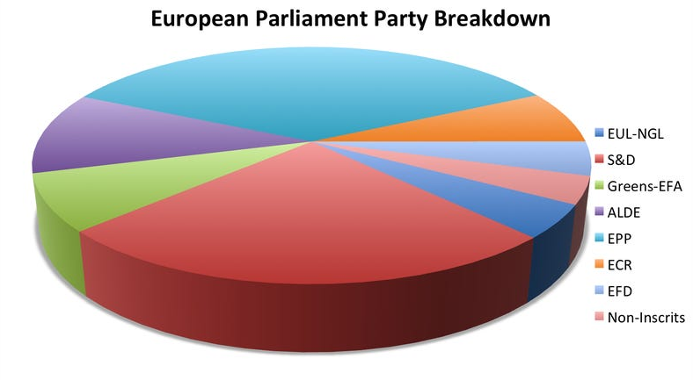
What could be improved?
Source
Notes:
From https://www.businessinsider.com/pie-charts-are-the-worst-2013-6

Slide 9
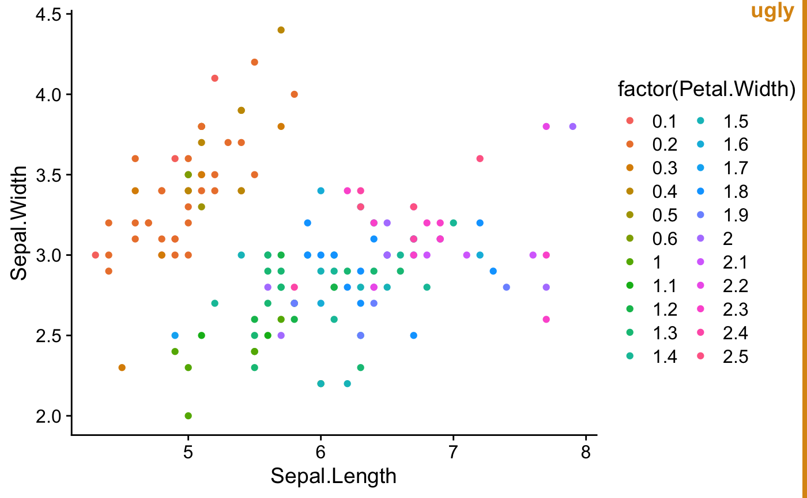
What could be improved?
Source
Notes:
From https://wilkelab.org/cowplot/reference/stamp.html

Slide 10
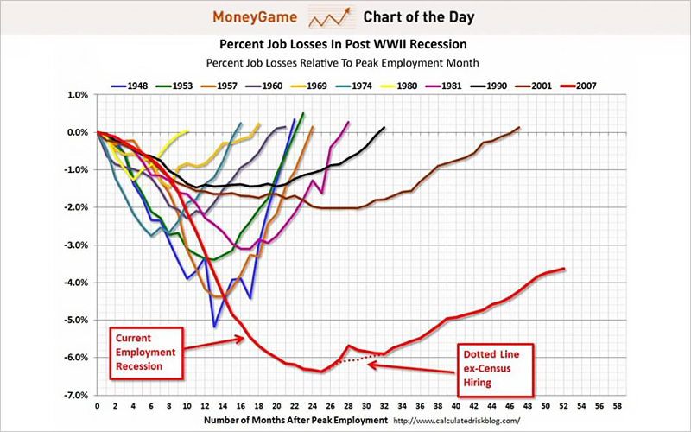
What could be improved?
Source
Notes:
From https://visme.co/blog/bad-infographics/

Slide 11
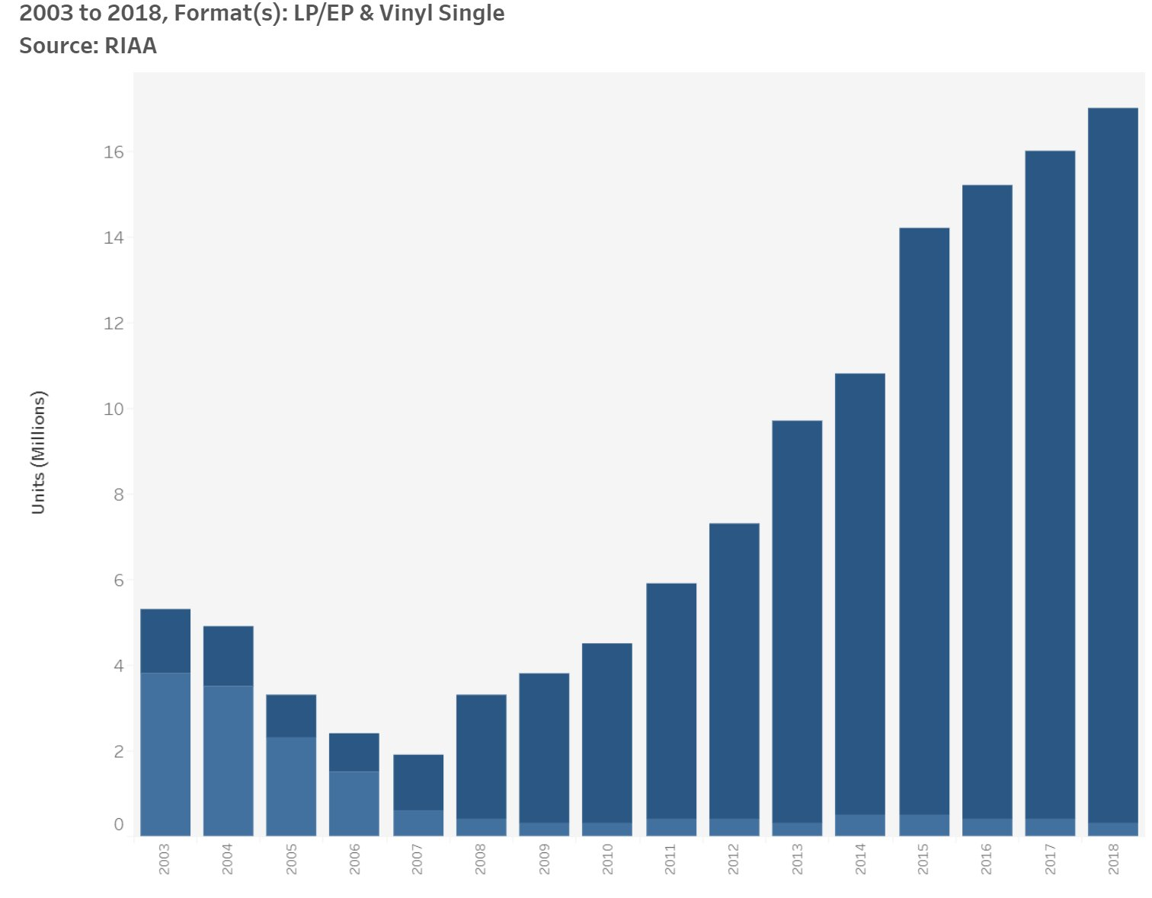
What could be improved?
Source

Slide 12
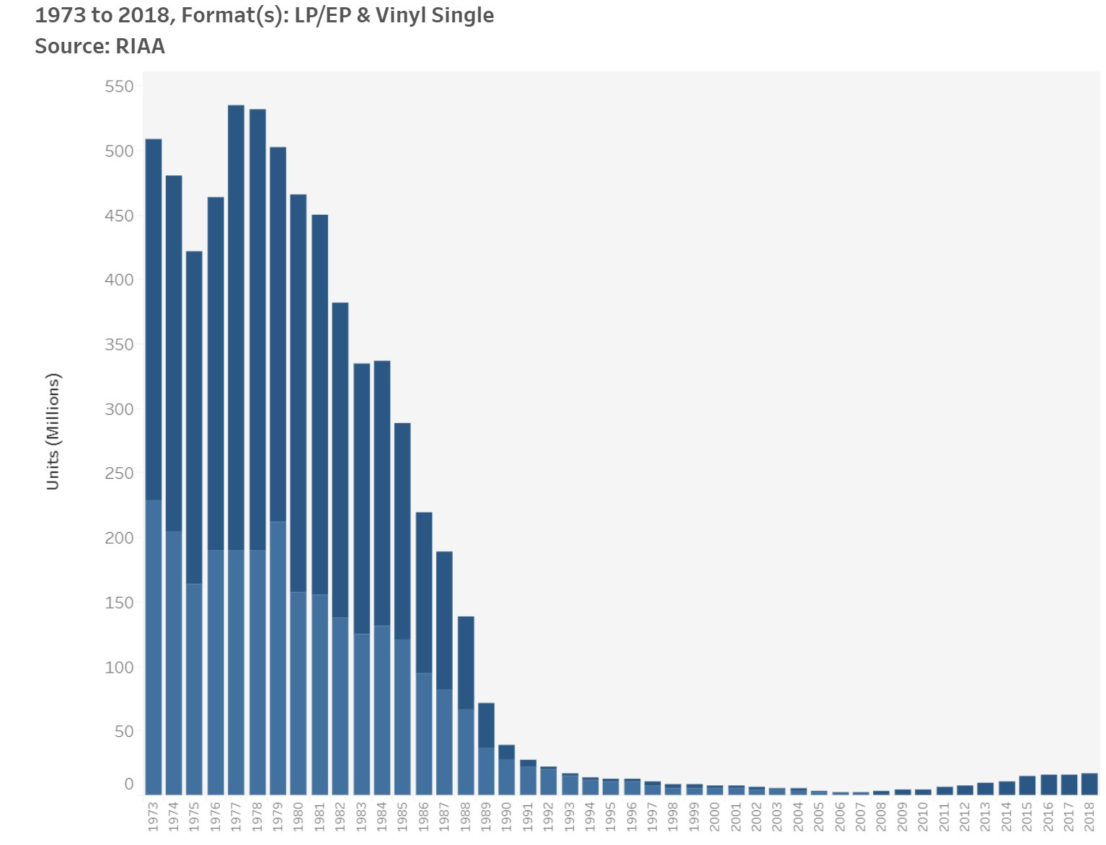
What could be improved?
Source

Slide 13
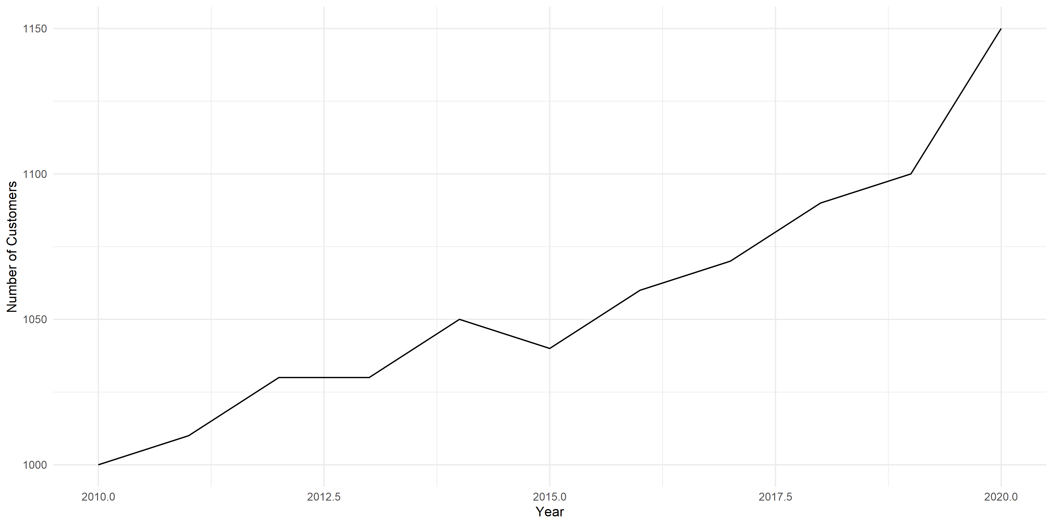
What could be improved?

Slide 14
Parts of a visualization

Slide 15
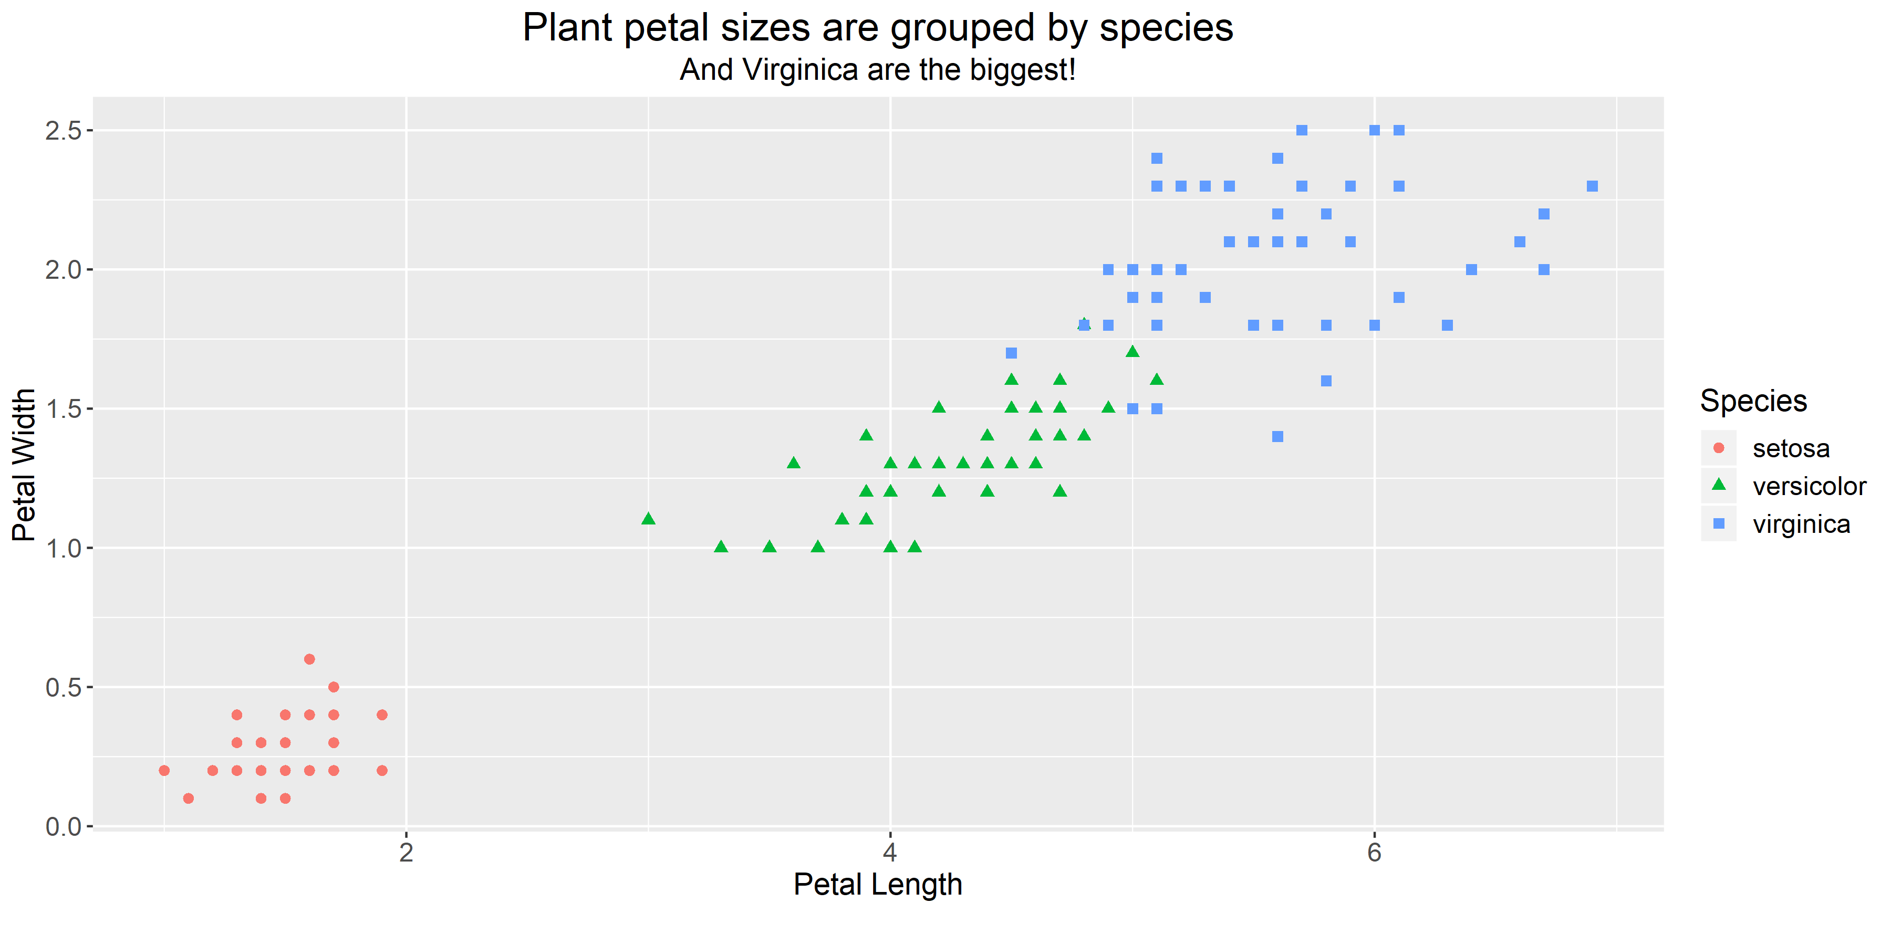
Background color
Title and subtitle (size, font, color, location)
Major & minor gridline frequency and color
Plot type & aesthetics (color, size, shape, opacity)
Legend title (size, font, color, location, existence)
X and Y axis labels (size, font, color, tilt)
Added text on the plot/animation
X and Y axis tick marks (frequency, label, size, color)

Slide 16
Seven best practices
Notes:
Seem obvious when you read them, but I’ve never seen them written down and I see them being broken all the time

Slide 17
For context: two types of data visualization
Exploratory → meant for you, don’t yet know what the data says
Explanatory → meant for audience, you know what you want to say
What we’re focusing on!

Slide 18
Seven best practices
Believe in bar, line, and scatter plots → your audience already recognizes them
Use reasonable axis tick lengths → the default may not make sense
Use color sparingly → and when you do use it, be intentional and internally consistent
Color gradients for density
If referring to the same thing in multiple plots, use the same color each time
Make your gridlines gray and don’t use minor gridlines
Legends (usually) suck
Use descriptive titles → tell your viewer what they should see
Traditional scientific titles are not explanatory
Don’t make your audience struggle – make your point as clear as possible
Make your text bigger than you’d think → nobody likes to squint
Consider your data-to-ink ratio → remove distractions

Slide 19
Seven best practices
Believe in bar, line, and scatter plots → your audience already recognizes them
Use reasonable axis tick lengths → the default may not make sense
Use color sparingly → and when you do use it, be intentional and internally consistent
Color gradients for density
If referring to the same thing in multiple plots, use the same color each time
Make your gridlines gray and don’t use minor gridlines
Legends (usually) suck
Use descriptive titles → tell your viewer what they should see
Traditional scientific titles are not explanatory
Don’t make your audience struggle – make your point as clear as possible
Make your text bigger than you’d think → nobody likes to squint
Consider your data-to-ink ratio → remove distractions
Notes:
Axis tick lengths:
Days, maybe make it 30-day intervals
Money, maybe every 100 or 10,000
Percentiles, maybe every .1 or .25

Slide 20
Seven best practices
Believe in bar, line, and scatter plots → your audience already recognizes them
Use reasonable axis tick lengths → the default may not make sense
Use color sparingly → and when you do use it, be intentional and internally consistent
Color gradients for density
If referring to the same thing in multiple plots, use the same color each time
Make your gridlines gray and don’t use minor gridlines
Legends (usually) suck
Use descriptive titles → tell your viewer what they should see
Traditional scientific titles are not explanatory
Don’t make your audience struggle – make your point as clear as possible
Make your text bigger than you’d think → nobody likes to squint
Consider your data-to-ink ratio → remove distractions
Notes:
Using color sparingly: color attracts attention, and that’s a finite resource that’d be better spent on your message. Default colors of plotting program are usually fine.

Slide 21
Seven best practices
Believe in bar, line, and scatter plots → your audience already recognizes them
Use reasonable axis tick lengths → the default may not make sense
Use color sparingly → and when you do use it, be intentional and internally consistent
Color gradients for density
If referring to the same thing in multiple plots, use the same color each time
Make your gridlines gray and don’t use minor gridlines
Legends (usually) suck
Use descriptive titles → tell your viewer what they should see
Traditional scientific titles are not explanatory
Don’t make your audience struggle – make your point as clear as possible
Make your text bigger than you’d think → nobody likes to squint
Consider your data-to-ink ratio → remove distractions

Slide 22
Seven best practices
Believe in bar, line, and scatter plots → your audience already recognizes them
Use reasonable axis tick lengths → the default may not make sense
Use color sparingly → and when you do use it, be intentional and internally consistent
Color gradients for density
If referring to the same thing in multiple plots, use the same color each time
Make your gridlines gray and don’t use minor gridlines
Legends (usually) suck
Use descriptive titles → tell your viewer what they should see
Traditional scientific titles are not explanatory
Don’t make your audience struggle – make your point as clear as possible
Make your text bigger than you’d think → nobody likes to squint
Consider your data-to-ink ratio → remove distractions
Notes:
Using color sparingly: color attracts attention, and that’s a finite resource that’d be better spent on your message. Default colors of plotting program are usually fine.

Slide 23
Seven best practices
Believe in bar, line, and scatter plots → your audience already recognizes them
Use reasonable axis tick lengths → the default may not make sense
Use color sparingly → and when you do use it, be intentional and internally consistent
Color gradients for density
If referring to the same thing in multiple plots, use the same color each time
Make your gridlines gray and don’t use minor gridlines
Legends (usually) suck
Use descriptive titles → tell your viewer what they should see
Traditional scientific titles are not explanatory
Don’t make your audience struggle – make your point as clear as possible
Make your text bigger than you’d think → nobody likes to squint
Consider your data-to-ink ratio → remove distractions

Slide 24
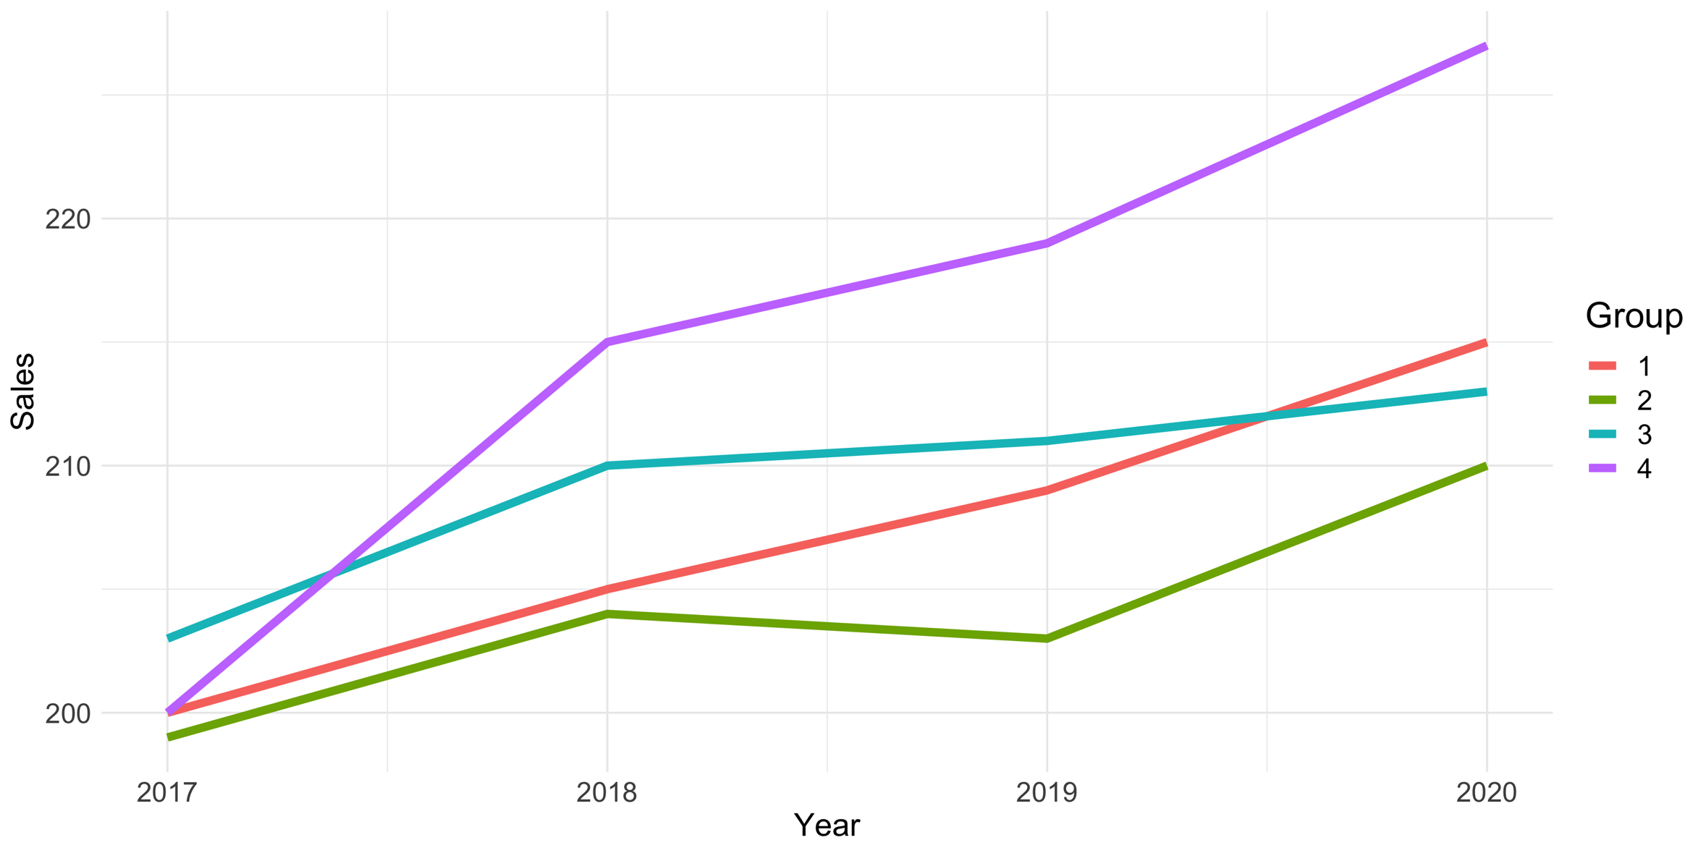
Why do legends suck?

Slide 25
Label your data directly
Group 4
Group 1
Group 3
Group 2

Slide 26
Label your data directly
Group 4
Group 1
Group 3
Group 2

Slide 27
Label your data directly

Slide 28
Seven best practices
Believe in bar, line, and scatter plots → your audience already recognizes them
Use reasonable axis tick lengths → the default may not make sense
Use color sparingly → and when you do use it, be intentional and internally consistent
Color gradients for density
If referring to the same thing in multiple plots, use the same color each time
Make your gridlines gray and don’t use minor gridlines
Legends (usually) suck
Use descriptive titles → tell your viewer what they should see
Traditional scientific titles are not explanatory
Don’t make your audience struggle – make your point as clear as possible
Make your text bigger than you’d think → nobody likes to squint
Consider your data-to-ink ratio → remove distractions
Notes:
Titles should not be just a regurgitation of the axis labels! What’s most important is not what the data is, but what the data means.
Want audience to spend as little time as possible deciphering your plot

Slide 29
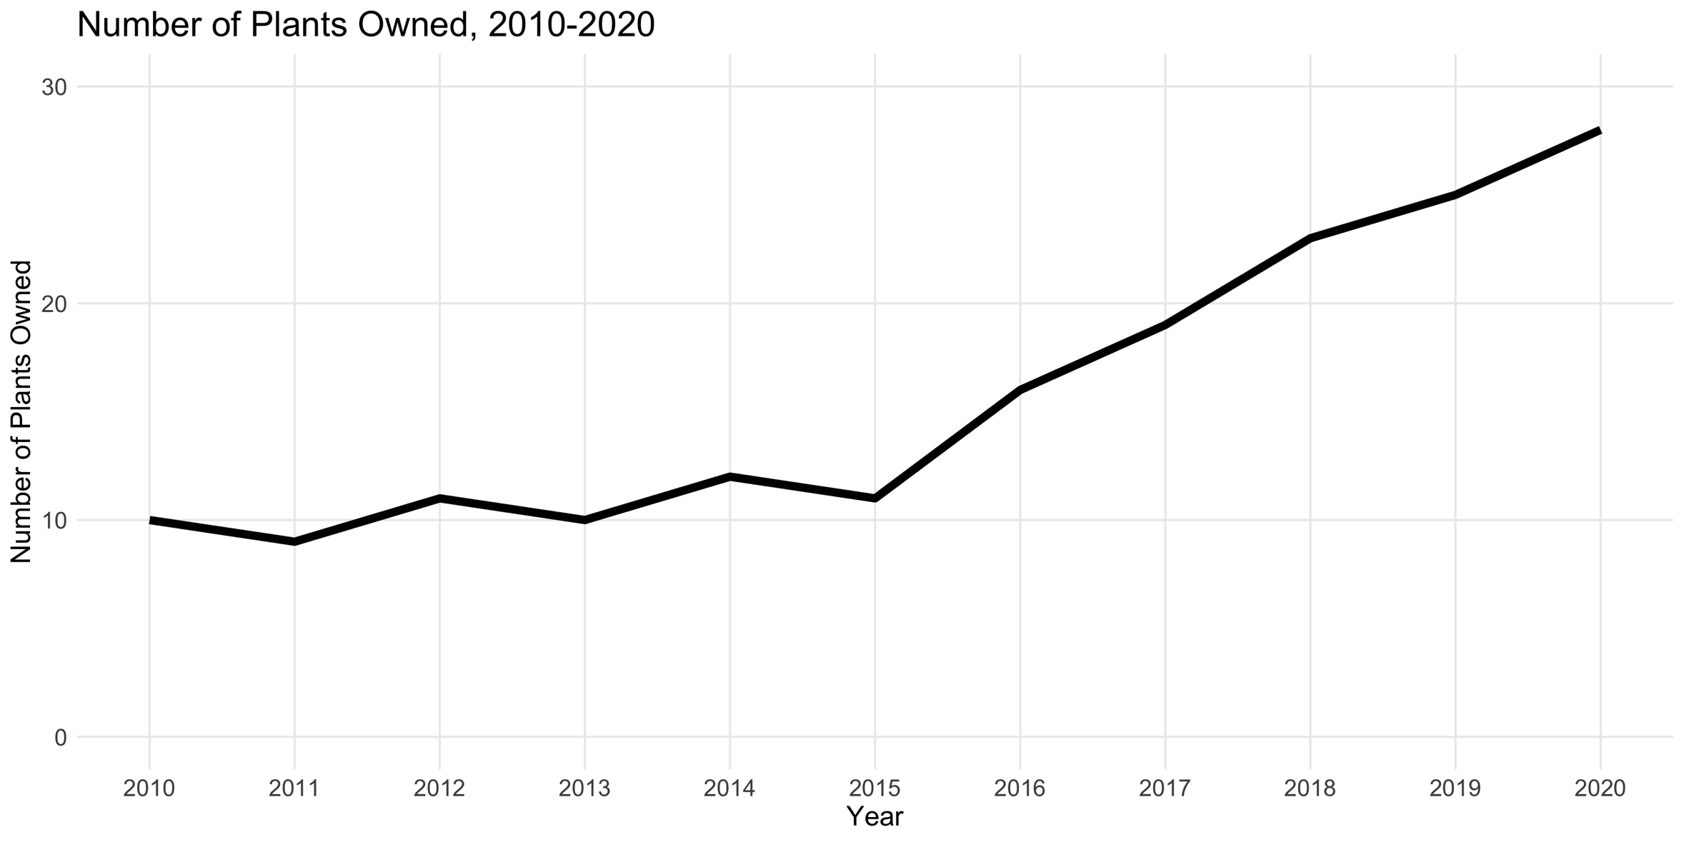
Tell your viewer what they should see
Notes:
What’s the message this plot is telling us???
If the title weren’t there, we would still know that → it’s not adding anything

Slide 30
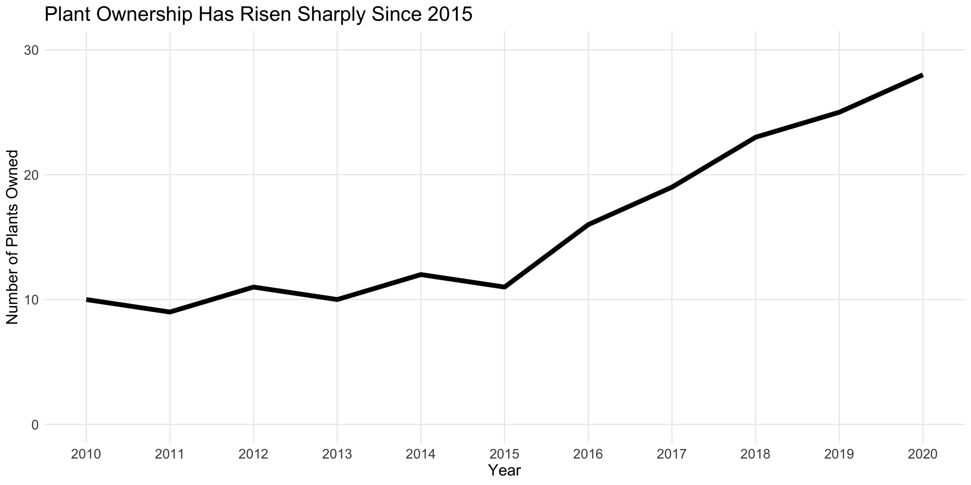
Tell your viewer what they should see

Slide 31
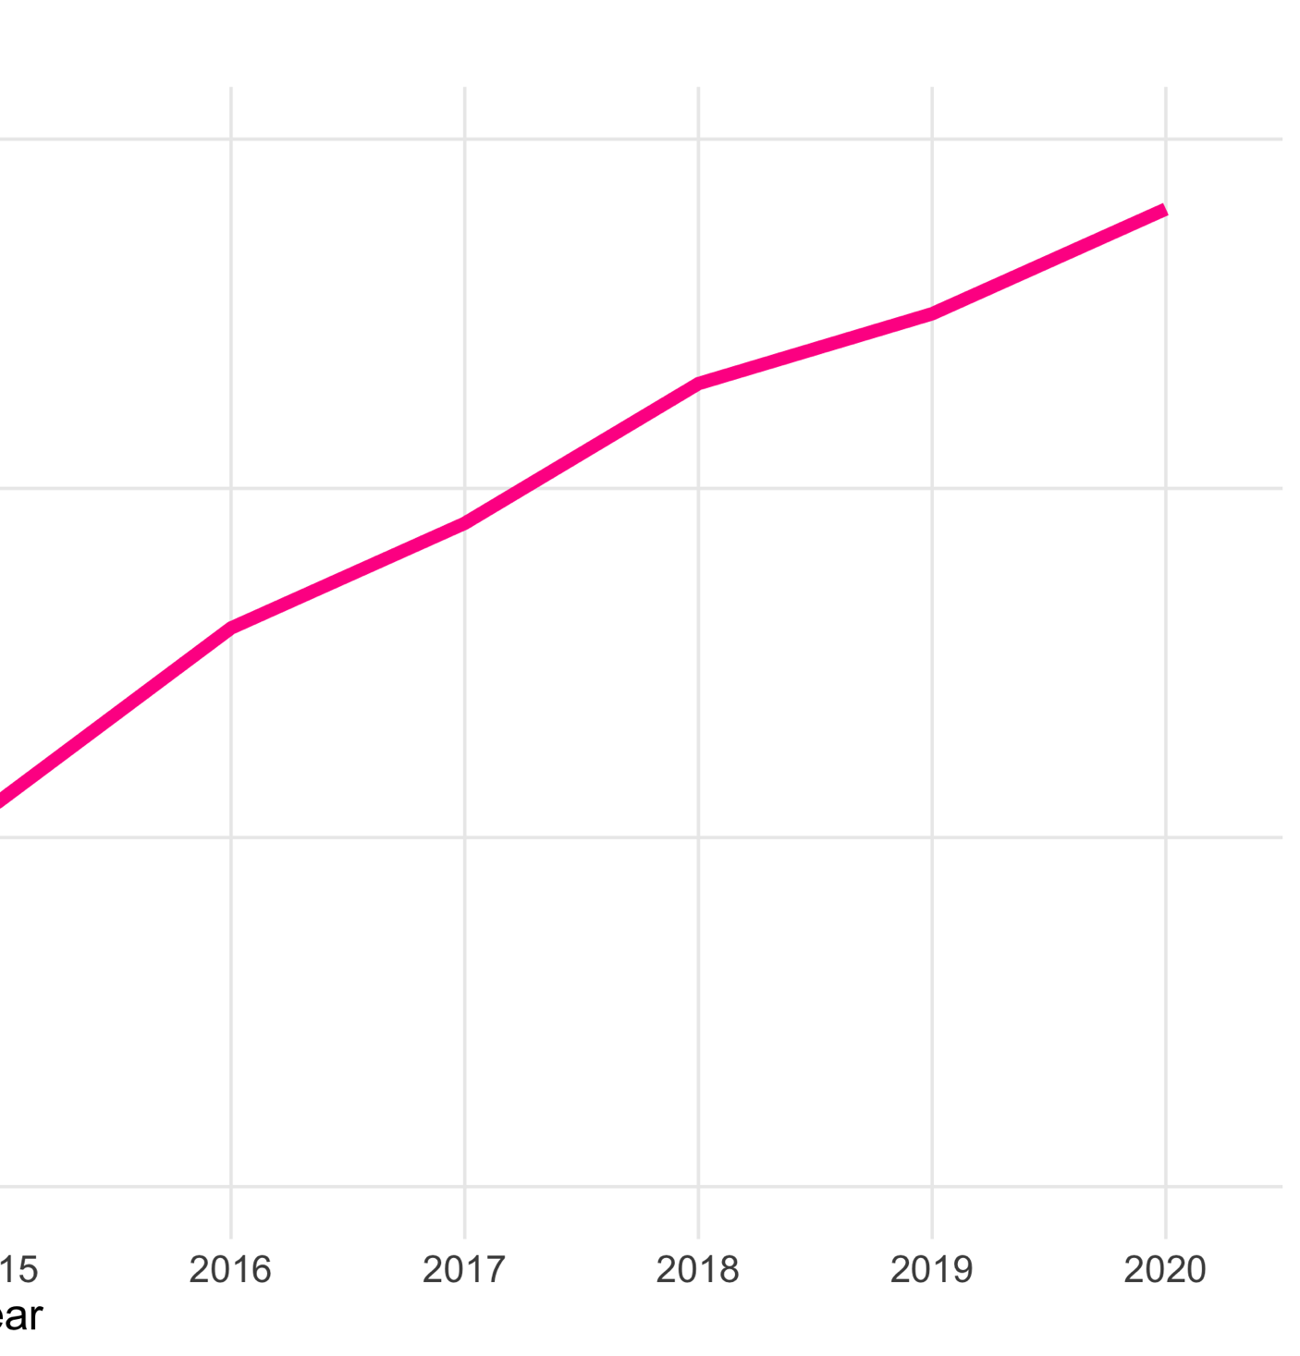
Tell your viewer what they should see
Risen Sharply Since 2015

Slide 32
Seven best practices
Believe in bar, line, and scatter plots → your audience already recognizes them
Use reasonable axis tick lengths → the default may not make sense
Use color sparingly → and when you do use it, be intentional and internally consistent
Color gradients for density
If referring to the same thing in multiple plots, use the same color each time
Make your gridlines gray and don’t use minor gridlines
Legends (usually) suck
Use descriptive titles → tell your viewer what they should see
Traditional scientific titles are not explanatory
Don’t make your audience struggle – make your point as clear as possible
Make your text bigger than you’d think → nobody likes to squint
Consider your data-to-ink ratio → remove distractions

Slide 33
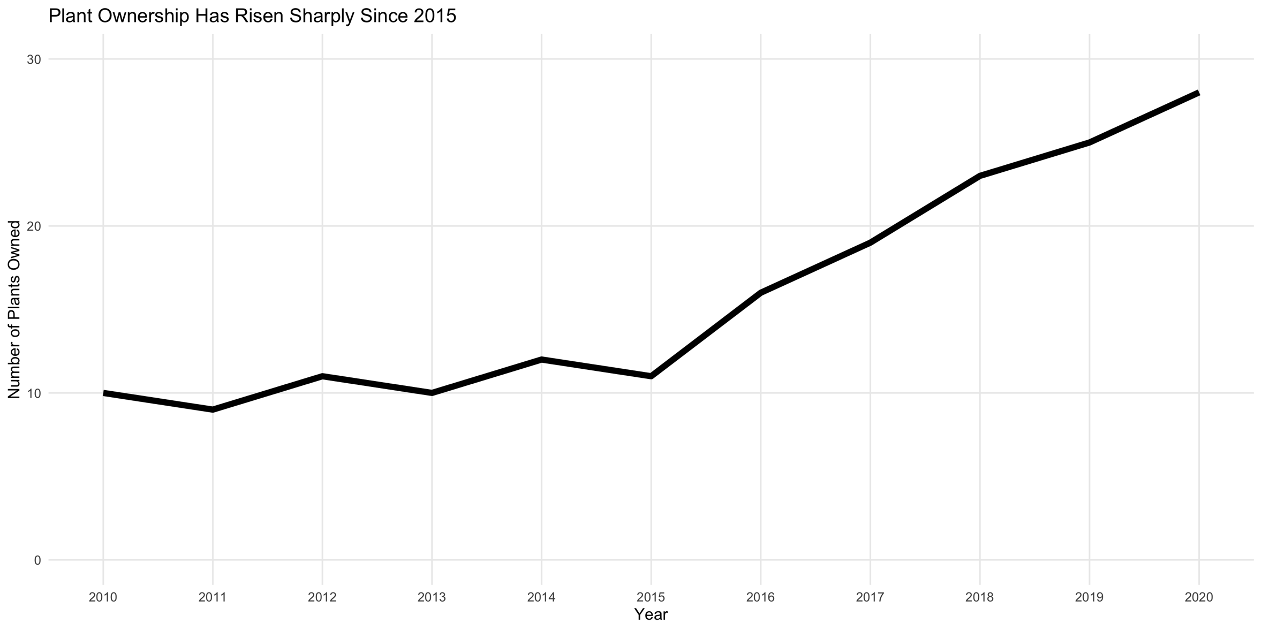
Nobody likes to squint!

Slide 34
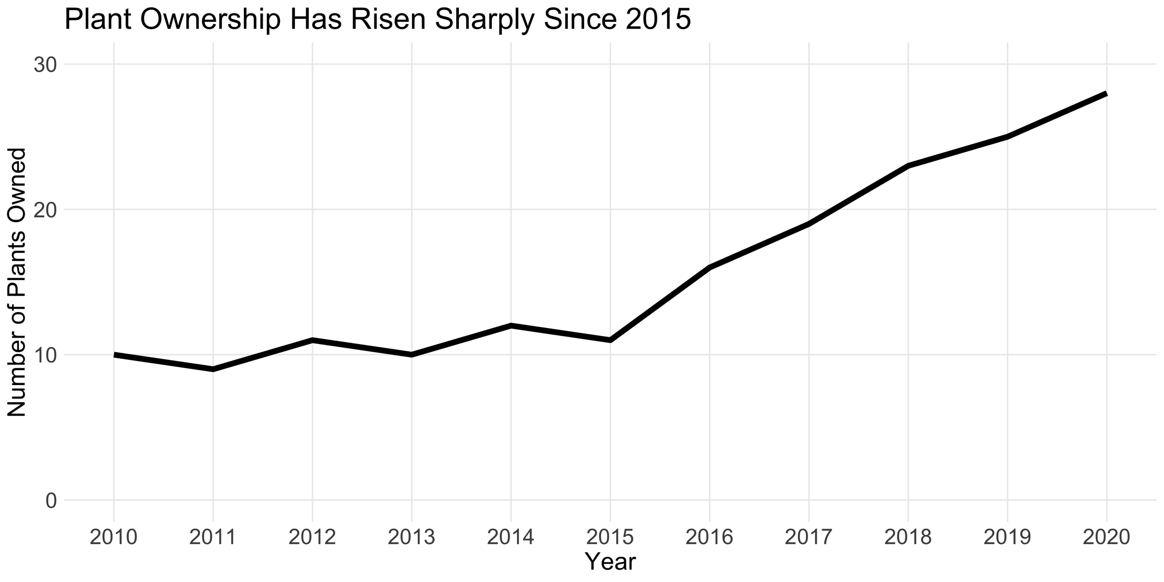
Nobody likes to squint!

Slide 35
Seven best practices
Believe in bar, line, and scatter plots → your audience already recognizes them
Use reasonable axis tick lengths → the default may not make sense
Use color sparingly → and when you do use it, be intentional and internally consistent
Color gradients for density
If referring to the same thing in multiple plots, use the same color each time
Make your gridlines gray and don’t use minor gridlines
Legends (usually) suck
Use descriptive titles → tell your viewer what they should see
Traditional scientific titles are not explanatory
Don’t make your audience struggle – make your point as clear as possible
Make your text bigger than you’d think → nobody likes to squint
Consider your data-to-ink ratio → remove distractions
Notes:
Data-to-ink ratio: closing eye & what’s first you see – as much data in as little ink

Slide 36
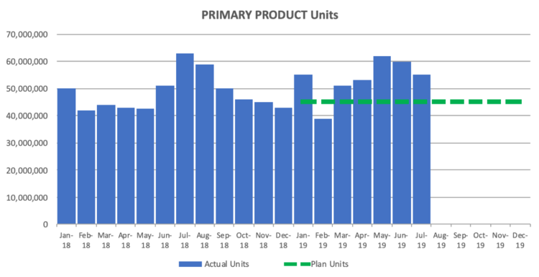
Things to remove
Source
Notes:
Storytelling with Data Source: https://drive.google.com/file/d/1XZkfeJi5D_FRjLNN02C2IoMev2Rscupp/view
Remove gridlines

Slide 37
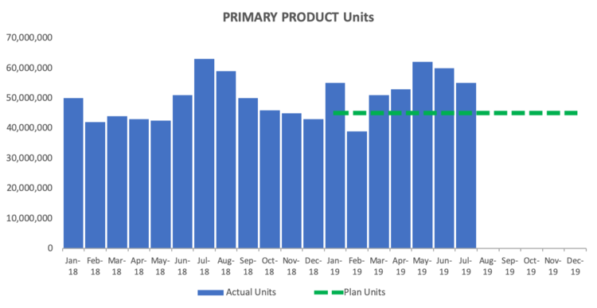
Things to remove
Source
Notes:
Storytelling with Data Source: https://drive.google.com/file/d/1XZkfeJi5D_FRjLNN02C2IoMev2Rscupp/view
Reformat y-axis

Slide 38
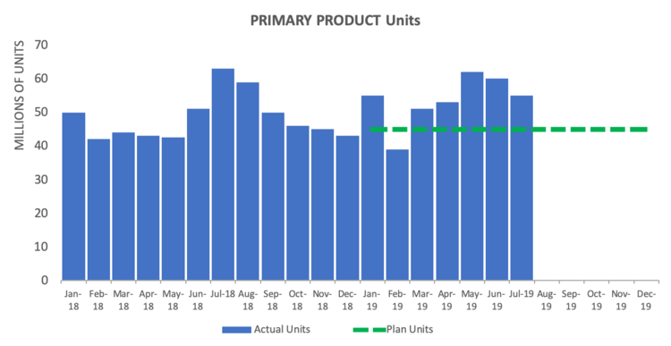
Things to remove
Source
Notes:
Storytelling with Data Source: https://drive.google.com/file/d/1XZkfeJi5D_FRjLNN02C2IoMev2Rscupp/view
Reformat x-axis

Slide 39
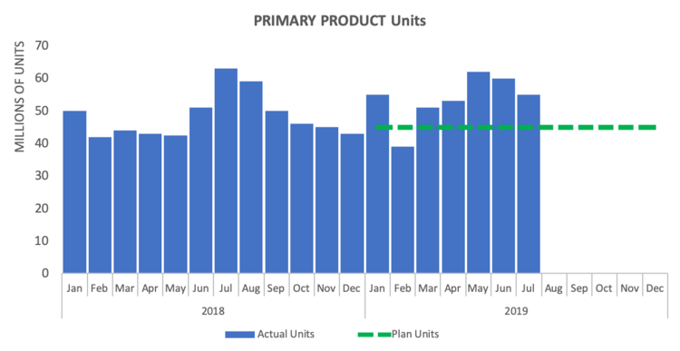
Things to remove
Source
Notes:
Storytelling with Data Source: https://drive.google.com/file/d/1XZkfeJi5D_FRjLNN02C2IoMev2Rscupp/view
Change and re-align title

Slide 40
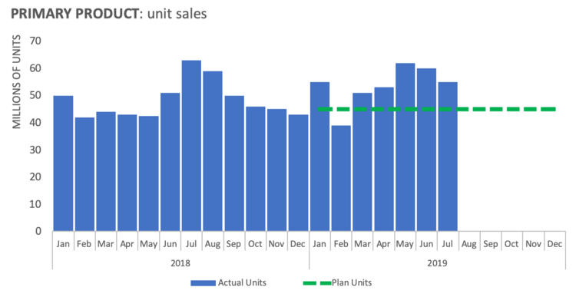
Things to remove
Source
Notes:
Storytelling with Data Source: https://drive.google.com/file/d/1XZkfeJi5D_FRjLNN02C2IoMev2Rscupp/view
Closing eyes practice on this page! Changing from bar plot to line plot

Slide 41
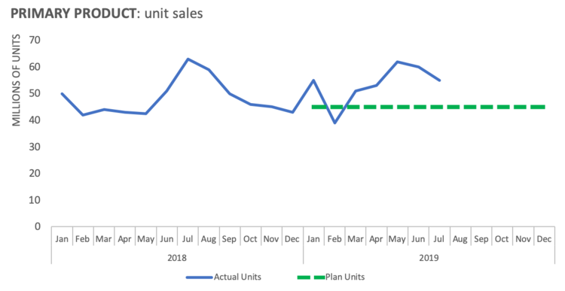
Things to remove
Source
Notes:
Storytelling with Data Source: https://drive.google.com/file/d/1XZkfeJi5D_FRjLNN02C2IoMev2Rscupp/view
Removing second color of plan units horizontal line.

Slide 42
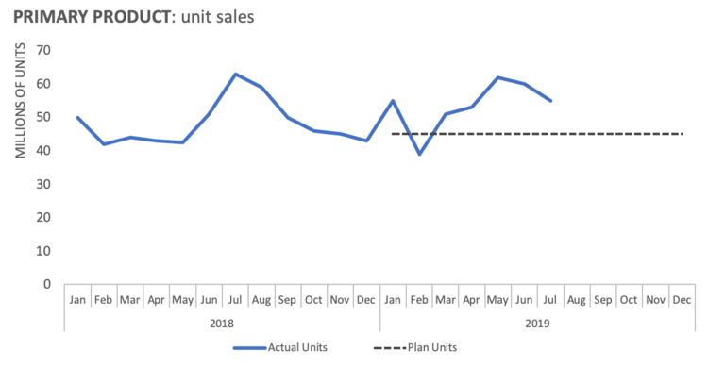
Things to remove
Source
Notes:
Storytelling with Data Source: https://drive.google.com/file/d/1XZkfeJi5D_FRjLNN02C2IoMev2Rscupp/view
Cutting out end of plot (in the future)

Slide 43
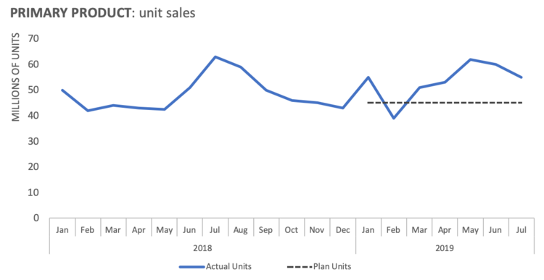
Things to remove
Source
Notes:
Storytelling with Data Source: https://drive.google.com/file/d/1XZkfeJi5D_FRjLNN02C2IoMev2Rscupp/view
Labeling directly on the plot

Slide 44
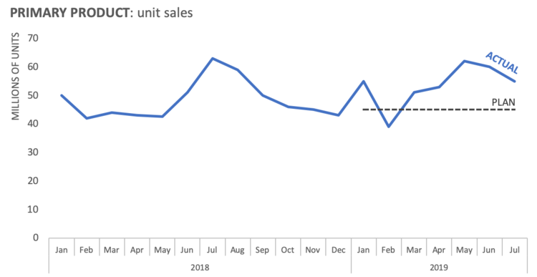
Things to remove
Source
Notes:
Storytelling with Data Source: https://drive.google.com/file/d/1XZkfeJi5D_FRjLNN02C2IoMev2Rscupp/view
Wrapping it up to make your point as clear as possible!

Slide 45
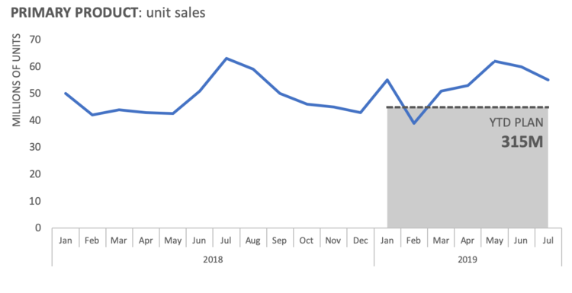
Things to remove
Source
Notes:
Storytelling with Data Source: https://drive.google.com/file/d/1XZkfeJi5D_FRjLNN02C2IoMev2Rscupp/view

Slide 46
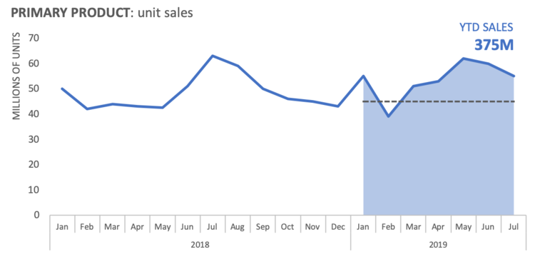
Things to remove
Source
Notes:
Storytelling with Data Source: https://drive.google.com/file/d/1XZkfeJi5D_FRjLNN02C2IoMev2Rscupp/view

Slide 47
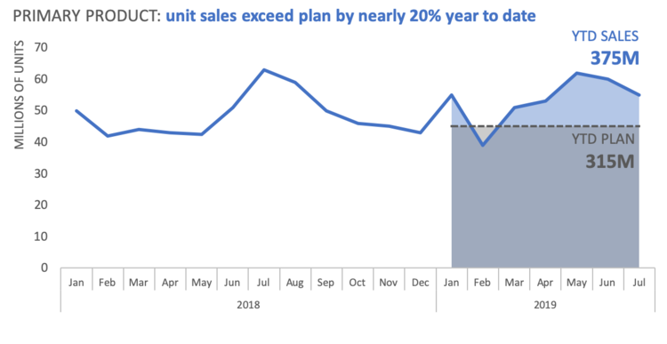
Things to remove
Source
Notes:
Storytelling with Data Source: https://drive.google.com/file/d/1XZkfeJi5D_FRjLNN02C2IoMev2Rscupp/view
This plot can stand on its own! Especially important if you won’t always be there to interpret the plot (e.g. publication, report)

Slide 48
Things to remove
Source
Notes:
Storytelling with Data Source: https://drive.google.com/file/d/1XZkfeJi5D_FRjLNN02C2IoMev2Rscupp/view
Combination of tiny removals and careful thought changed the plot entirely

Slide 49
Drawing from tabular data

Slide 50
Budget (thousands) | Director Gender | Ticket Sales (thousands)
100 | Female | 500
200 | Female | 600
300 | Female | 750
400 | Female | 800
500 | Female | 900
600 | Female | 950
700 | Female | 1,000
800 | Female | 1,050
900 | Female | 1,100
1,000 | Female | 1,100
Budget (thousands) | Director Gender | Ticket Sales (thousands)
100 | Male | 50
200 | Male | 100
300 | Male | 250
400 | Male | 400
500 | Male | 500
600 | Male | 750
700 | Male | 900
800 | Male | 1,000
900 | Male | 1,200
1,000 | Male | 1,500

Slide 51
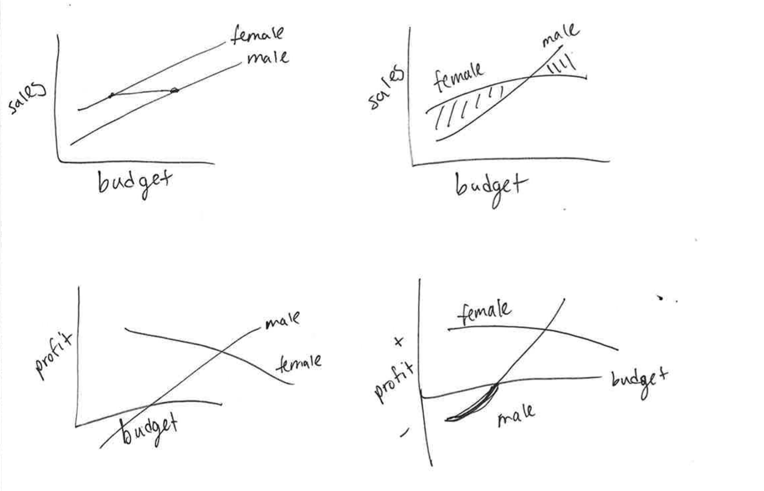
Initial sketches of plots

Slide 52
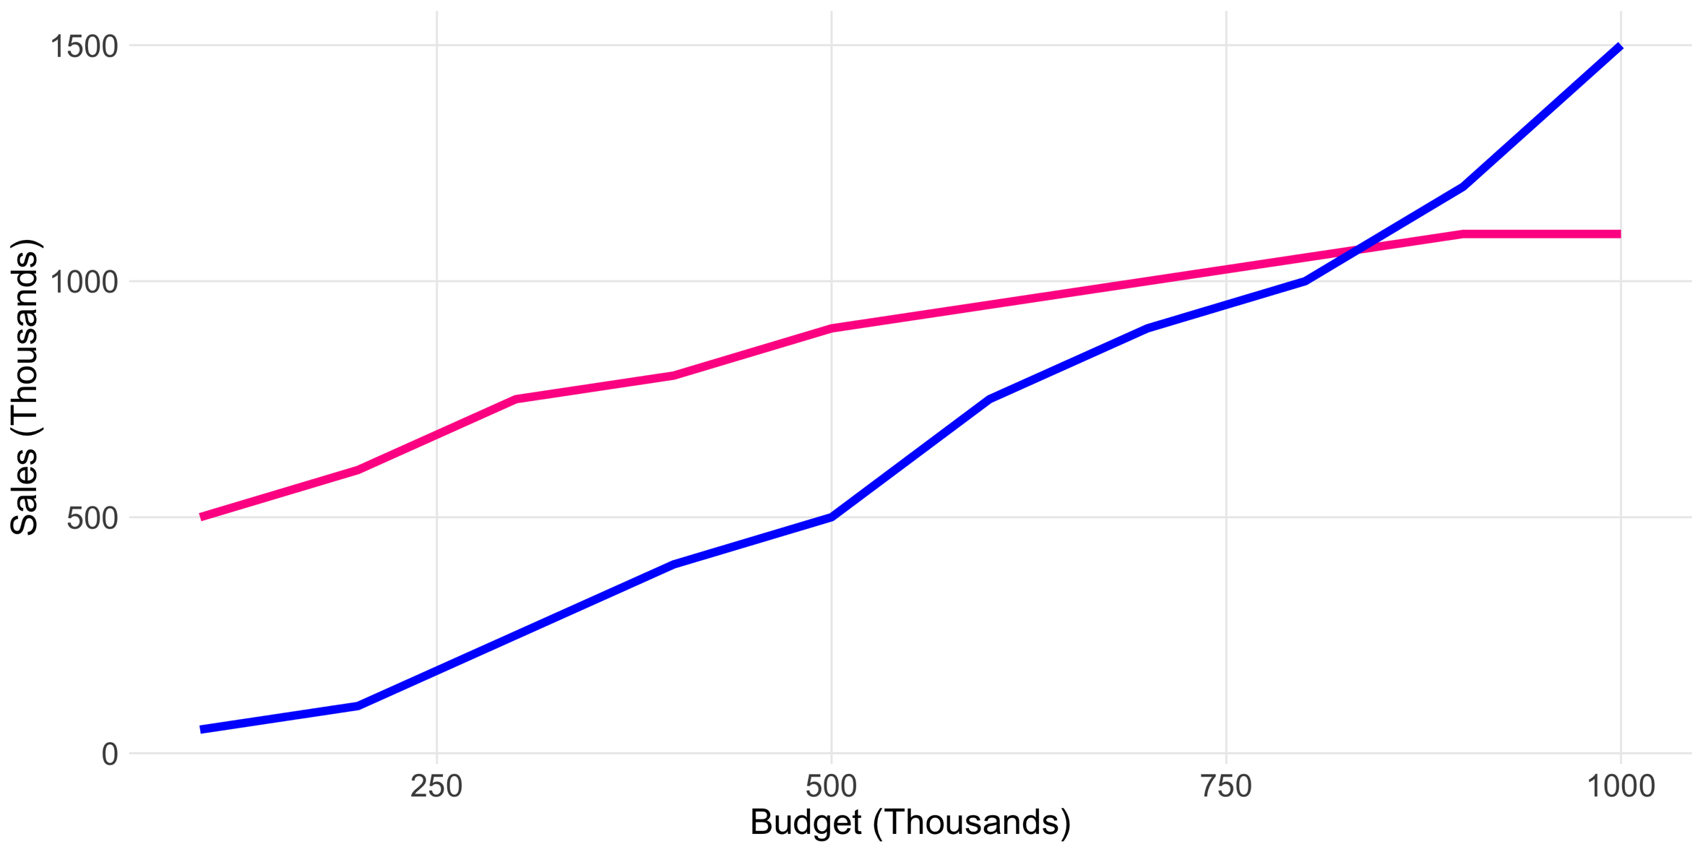
Female directors can make the same ticket sales as male directors, with $400 less in budget.
Female
Directors
Male
Directors

Slide 53
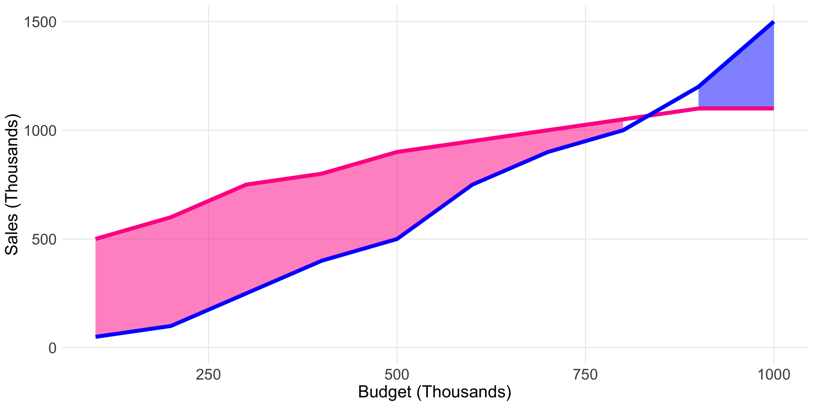
Female directors outperform male directors on smaller budget (<$800) films.
Female
Directors
Male
Directors

Slide 54
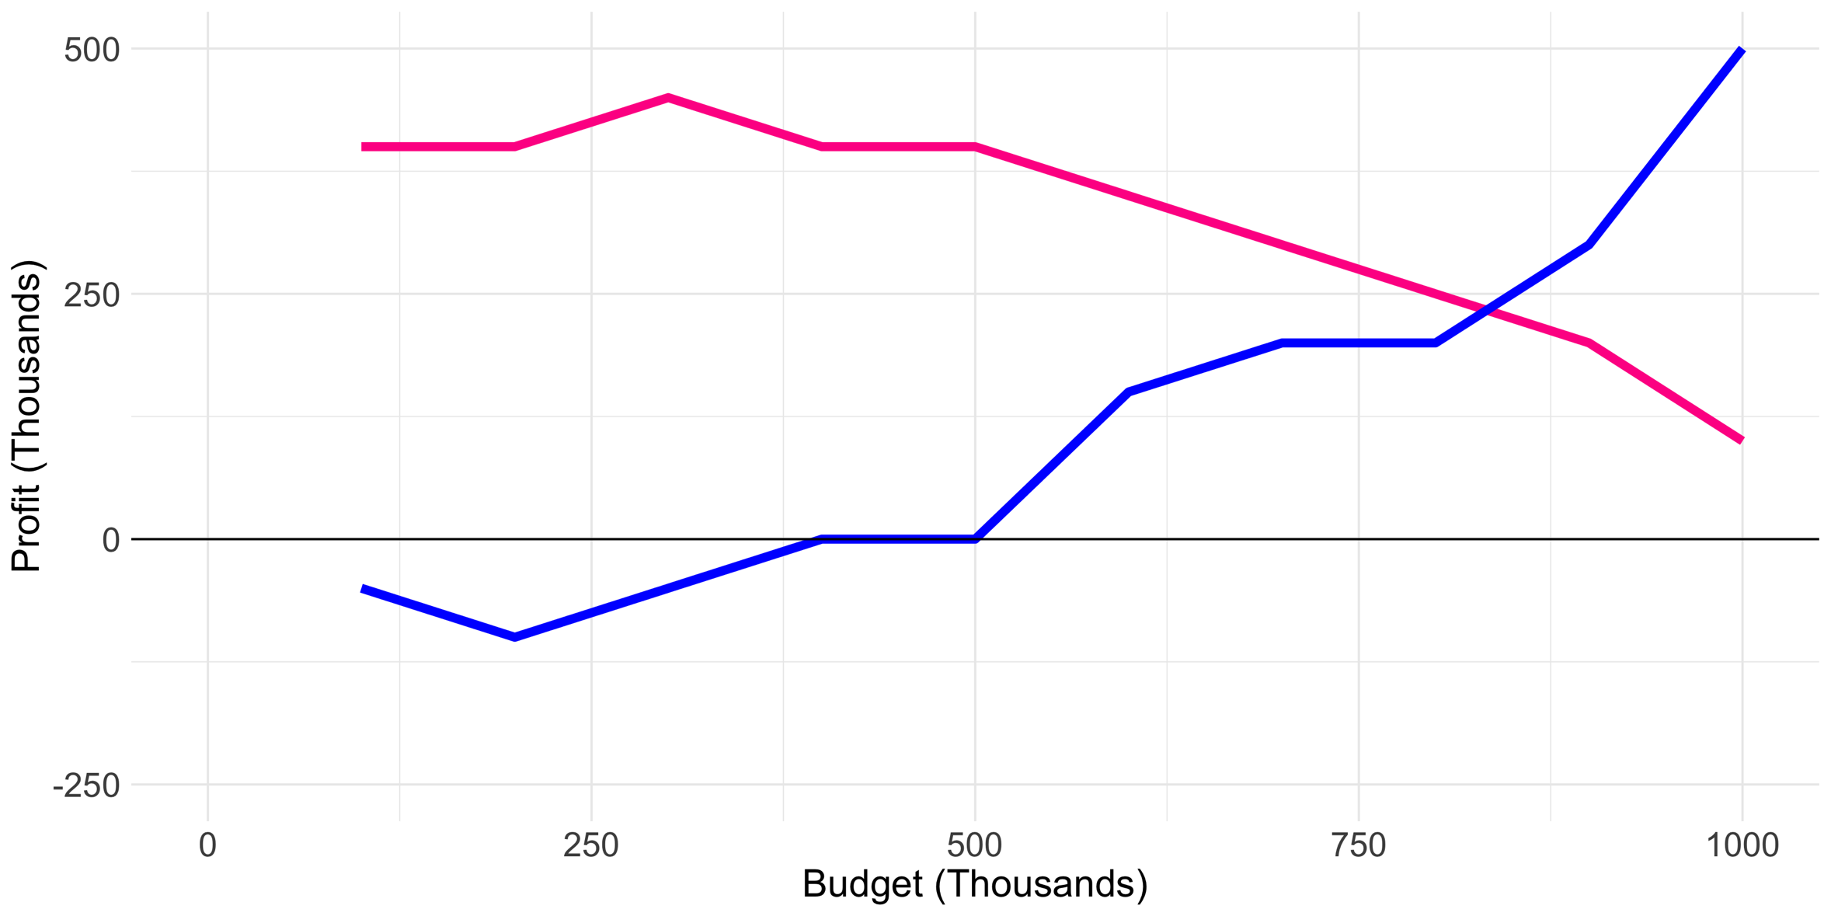
Female
Directors
Male
Directors
Male directors are unprofitable with budgets less than $500.

Slide 55
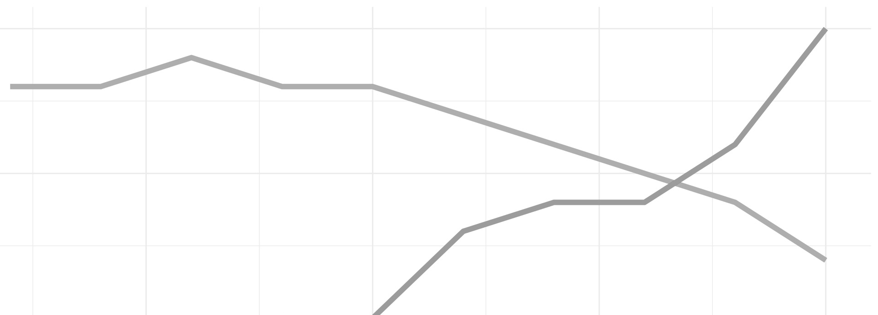
Female
Directors
Male directors are unprofitable with budgets less than $500.

Slide 56
Thank you!
https://github.com/ktebbe/DataViz

Slide 57
Additional resources
Storytelling with Data books - http://www.storytellingwithdata.com/books
Free e-book on visualization- https://serialmentor.com/dataviz/
Intro to ggplot in R - https://www.williamrchase.com/slides/ggplot_intro.html andhttps://evamaerey.github.io/ggplot_flipbook/ggplot_flipbook_xaringan.html#1
ggplot examples https://wilkelab.org/practicalgg
Slide deck on data communication - https://www.amelia.mn/TeachingDataCommunication.pdf

